Slide 1
Welcome to the June 10, 2025,
Prosper Town Council Meeting

Slide 2
Call to Order/Roll Call

Slide 3
Invocation, Pledge of Allegiance, and Pledge to the Texas Flag.

Slide 4
Pledge to the Texas Flag
Honor the Texas flag; I pledge allegiance to thee, Texas, one state under God, one and indivisible.

Slide 5
Announcements

Slide 6
Presentations
Agenda Item 1.
Presentation from the Prosper Chamber of Commerce recognizing the inaugural class of Leadership Prosper. (MLS)

Slide 7
Consent Agenda
Agenda Item 2.
Consider and act upon the minutes of the May 27, 2025, Town Council Regular meeting. (MLS)

Slide 8
Agenda Item 3.
Consider and act upon a contract between Mosquito Management Services and the Town of Prosper for mosquito mitigation/testing in the amount of $75,595 and authorize the Town Manager to execute documents for same. (DH)

Slide 9
Agenda Item 4.
Consider and act upon approving a purchase with Fuquay, Inc., to rehabilitate 15 wastewater manholes for $222,268 and authorizing the Town Manager to execute documents for same. (CJ)

Slide 10
Agenda Item 5.
Consider and act upon authorizing the Town Manager to execute a Construction Agreement between the Town of Prosper and Turf Concepts, LLC. for provision and installation of artificial turf in the Downtown Plaza for $64,725. (DB)

Slide 11
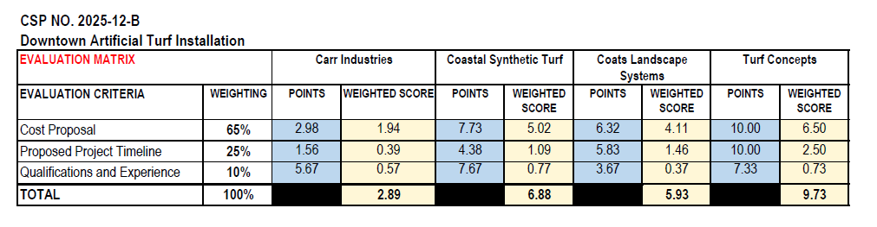

Slide 12
Agenda Item 6.
Consider and act upon an ordinance abandoning a portion of Coleman Street prescriptive right-of-way, located south of First Street, beginning at a point approximately 300 feet south of First Street and extending south approximately 1,600 feet to the intersection with Lovers Lane. (HW)

Slide 13
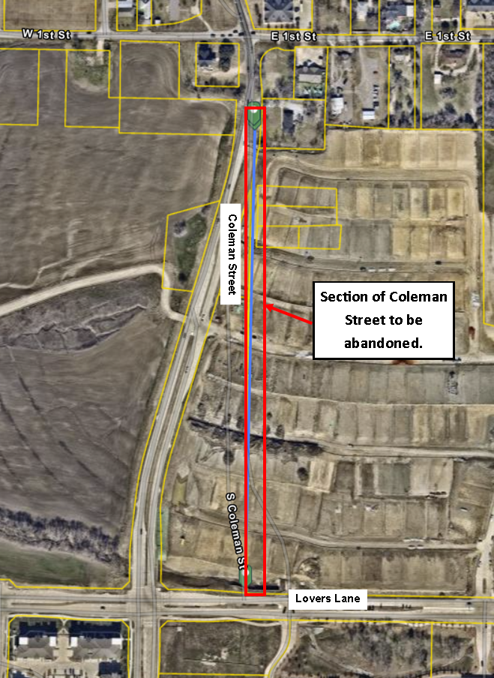

Slide 14
Agenda Item 7.
Consider and act upon an ordinance abandoning a portion of Good Hope Road prescriptive right-of-way, beginning at Berylline Lane and extending northeast approximately 800 feet to a point approximately 50 feet north of Kinglet Court. (HW)

Slide 15
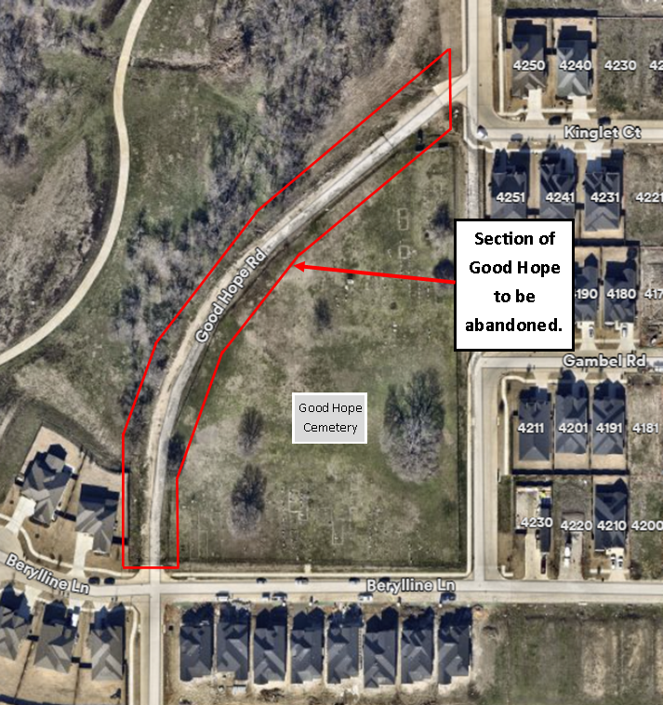

Slide 16
Agenda Item 8.
Consider and act upon authorizing the Town Manager to execute a Construction Agreement awarding CSP No. 2025-08-B to J&L Construction, LLC, related to the FM 1461 12-inch Water Line Relocation project, for $4,085,802.90 and authorize $400,000 for construction phase contingencies. The total purchase order amount is $4,485,802.90. (PA)

Slide 17
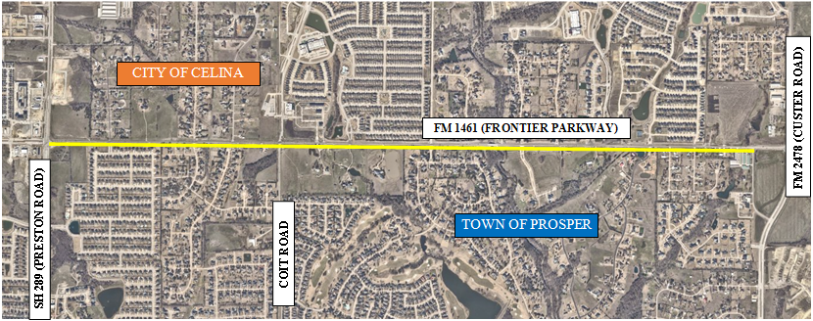
Bids Received:
Eight (8) – March 20, 2025
Updated CSP Percentages:
  Cost Proposal =65%
  Project Timeline =25%
  Qualifications/Exp =10%
Range of Proposals (Cost):
$4,085,802.90 - $8,032,594
Engineers Estimate:
$7,364,213
Budget:
$6,000,00
Range of Proposals (Time):
180 days - 425 days
Recommendation:
J&L Construction, LLC
$4,085,802.90
180 days

Slide 18
Agenda Item 9.
Consider and act upon authorizing the Town Manager to execute a Professional Services Agreement between Raba Kistner, Inc., and the Town of Prosper, Texas, related to professional construction materials testing and observation services for the FM 1461 12-inch Water Line Relocation project for $63,020. (PA)

Slide 19
Agenda Item 10.
Consider and act upon whether to direct staff to submit a written notice of appeals on behalf of the Town Council to the Development Services Department, pursuant to Chapter 4, Section 1.5(C)(7) and 1.6(B)(7) of the Town’s Zoning Ordinance, regarding action taken by the Planning & Zoning Commission on Preliminary Site Plans and Site Plans. (DH)

Slide 20
Folsom Elementary School
Temporary Buildings
(DEVAPP-25-0053)

Slide 21
Information
Purpose:
Add four temporary buildings totaling 7,575 square feet to an existing elementary school.
  Accommodating additional enrollment at Rucker Elementary due to new school being constructed.
History:
A site plan for a temporary building at Folsom Elementary (D14-0005) was approved by the Planning & Zoning Commission on June 20, 2023.
Zoning Ordinance:
Temporary buildings are permitted by right for public schools (K-12).

Slide 22
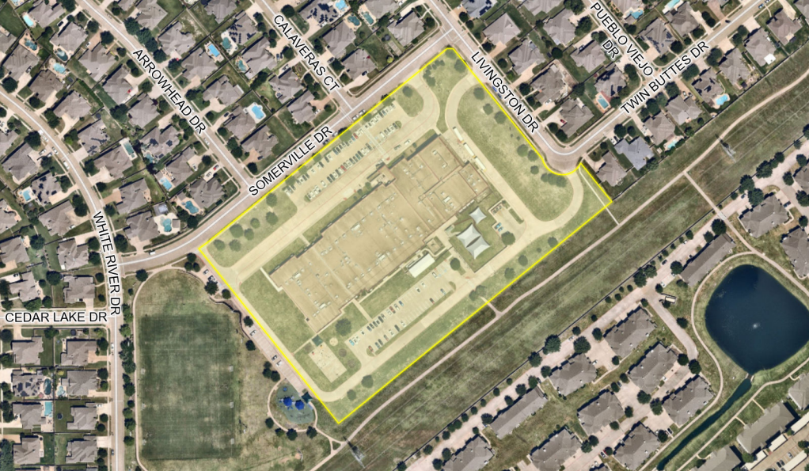

Slide 23
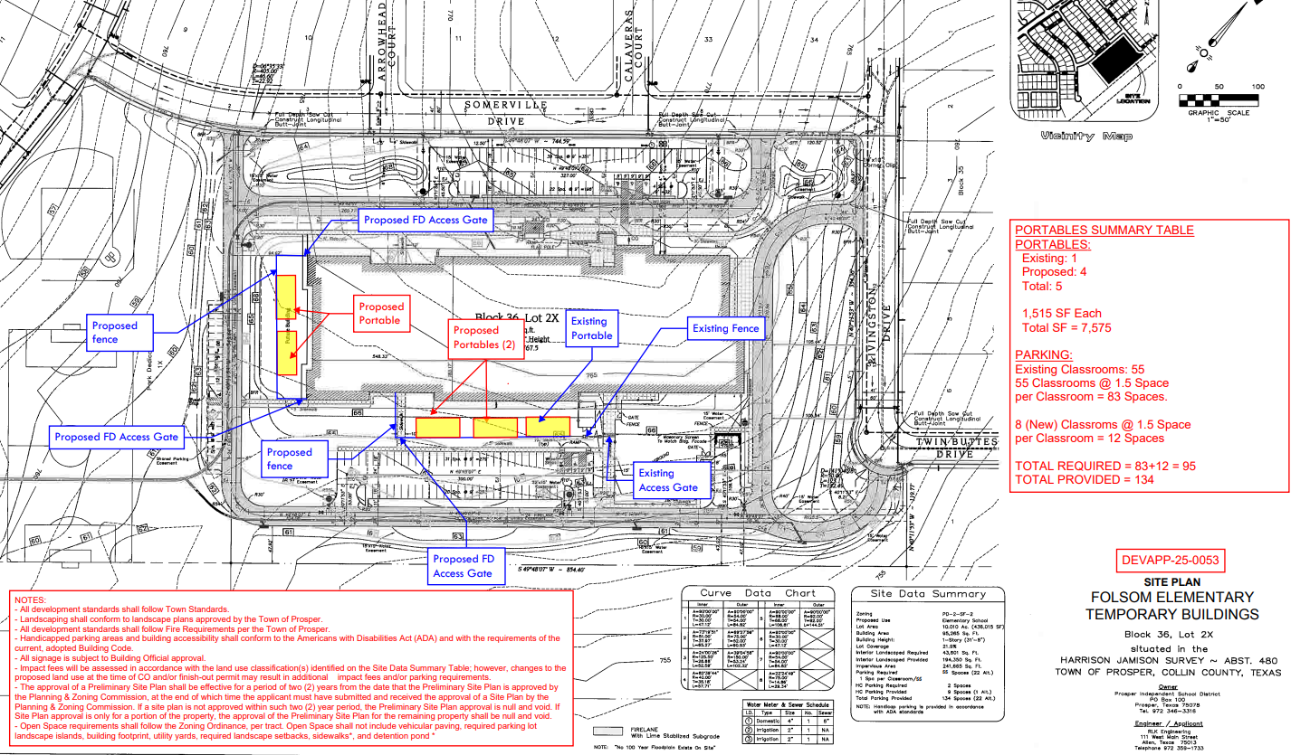

Slide 24
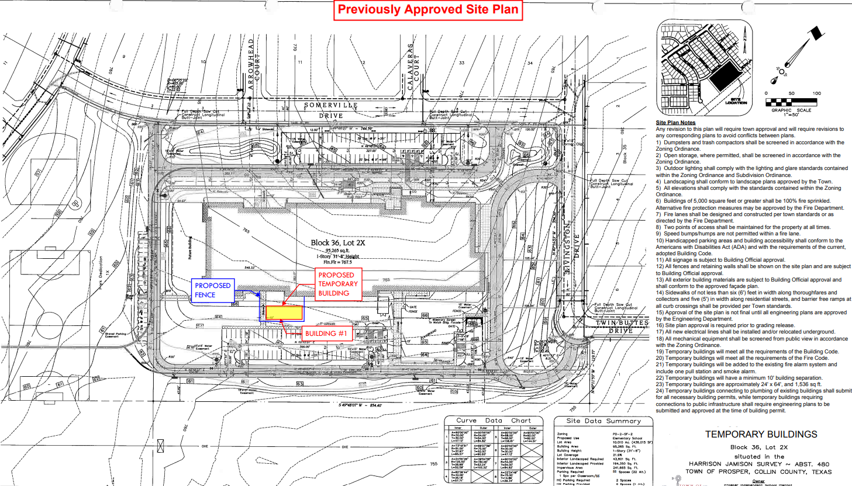

Slide 25
Citizen Comments

Slide 26


Slide 27
Regular Agenda
Pursuant to Section 551.007 of the Texas Government Code, individuals wishing to address the Council for items listed as public hearings will be recognized when the public hearing is opened.

Slide 28
Agenda Item 11.
Consider all matters incident and related to the issuance and sale of "Town of Prosper, Texas, Waterworks and Sewer System Revenue Bonds, Series 2025", including the adoption of an ordinance authorizing the issuance of such bonds and establishing procedures and delegating authority for the sale and delivery of such bonds. (CL)

Slide 29
Parameters for Issuance of $33,896,633 of Revenue Bonds
Parameters approach allows staff to choose best time to issue which is currently planned for August 12th or later
Key parameters include:
  Amount not to exceed $34,850,000;
  True interest cost of 5.00% or less;
  Maximum maturity of 20 years.

Slide 30
Revenue Bonds: $33,896,633
Wastewater Projects | Amount
Doe Branch Expansion, Phase 3 WWTP: 2322-WW | $27,500,000
Doe Branch Parallel Interceptor: 2103-WW | $3,750,000
Subtotal Wastewater | $31,250,000
Water Projects | Amount
Parks & Public Works Service Center, Phase 1: Construction | $2,646,633
Subtotal Water | $2,646,633
TOTAL REVENUE BONDS ISSUANCE | $33,896,633

Slide 31
Agenda Item 12.
Consider all matters incident and related to the issuance and sale of "Town of Prosper, Texas, General Obligation Refunding and Improvement Bonds, Series 2025", including the adoption of an ordinance authorizing the issuance of such bonds and establishing procedures and delegating authority for the sale and delivery of such bonds. (CL)

Slide 32
Parameters for Issuance of $49,735,000 of General Obligation Refunding and Improvement Bonds:
$19,450,000 (new money) and $30,285,000 (refunding)
Parameters approach allows staff to choose best time to issue which is currently planned for August 12th or later
Key parameters include:
  True interest cost of 5.00% of less;
  Maximum maturity of 20 years for new money;
  Maximum maturity of 10 years for refunding;
Debt Service property tax rate will remain approximately the same

Slide 33
New Money: $19,450,000
Prop C | Streets and Transportation Projects | Amount
1512-ST | First Street (DNT - Coleman): (Construction) | 9,000,000
1710-ST | Coit Road (First - Frontier) - 4 lanes: (Construction) | 8,200,000
2142-ST | Coleman (Prosper Trail - Talon) - 2 SB lanes: (Land/Esmt) | 1,500,000
 | Legacy (First - Prosper Trail) - 2 SB lanes: (Land/Esmt) | 550,000
 | Legacy (First - Prosper Trail) - 2 SB lanes: (Construction) | 200,000
Subtotal Streets |  | $ 19,450,000
GRAND TOTAL NEW MONEY |  | $ 19,450,000

Slide 34
Refunding: $30,285,000
Series | Type | Call Date | Currently Outstanding
2014 | Certificates of Obligation | 8/15/2024 – Currently Callable | 7,495,000
2015 | Certificates of Obligation | 2/15/2025 – Currently Callable | 5,420,000
2015 | General Obligation | 2/15/2025 – Currently Callable | 6,920,000
2016 | Certificates of Obligation | 2/15/2025 – Currently Callable | 7,140,000
2016 | General Obligation | 2/15/2025 – Currently Callable | 3,310,000
GRAND TOTAL REFUNDING |  |  | $ 30,285,000

Slide 35

Jason Hughes
Senior Managing Director
June 10, 2025
Town of Prosper

Slide 36
MMD Interest Rate Movement in 2025

Slide 37
MMD Interest Rate Movement in 2025

Slide 38
Parameter Bond Sale
Council delegates final pricing authority to Pricing Officers
Council establishes bond sale parameters:
  Maximum interest rate
  Maximum principal amount of bond issue
  Minimum savings level for refunding component
  Final maturity date
  Expiration of delegated authority
Pricing Officers can only approve sale if ALL Council approved parameters are met
Reason for Parameter Bond Sale = FLEXIBILITY
  Especially beneficial in a market experiencing significant volatility
Market Timing – Bond issue is in ‘Day-to-Day’ mode, meaning the bonds can be priced at any time and in an interest rate environment that is advantageous rather than being locked into pricing on the date of a Council meeting

Slide 39
Suggested Parameters

Slide 40
GO Refunding Candidates

Slide 41
Agenda Item 13.
Consider and act upon a Professional Services Agreement between Emergifire, LLC., and the Town of Prosper to implement a program to charge mitigation rates for the deployment of emergency and non-emergency services provided by Prosper Fire Rescue. (SB)

Slide 42


Proposal for fire response billing
emergifire.com 833-BILLFIRE
info@emergifire.com

Slide 43

Expanded from Emergicon – EMS Billing
Zero Upfront Costs – Percentage of collections only.
Integrates into our existing reporting system to identify and pursue insurance billing opportunities.
Directly through commercial policy claim.
FEMA and National Averages Fees Assessed
Taxes pay for readiness, but often fail to cover the cost of utilization, especially for major incidents.

Slide 44
EMERGIFIRE helps departments target insurance reimbursement for costs incurred.
Insurance carriers have long included fire department service charge recovery clauses in their policies to help pay for costs related to fire incident and first response.
Unfortunately, many departments do not have the processes and personnel in place to identify and pursue reimbursement claims for commercial and industrial-related incidents therefore causing a strain on budgets.
A key benefit of fire billing is that it is focused on insurance carriers, not residents.

Slide 45


Slide 46
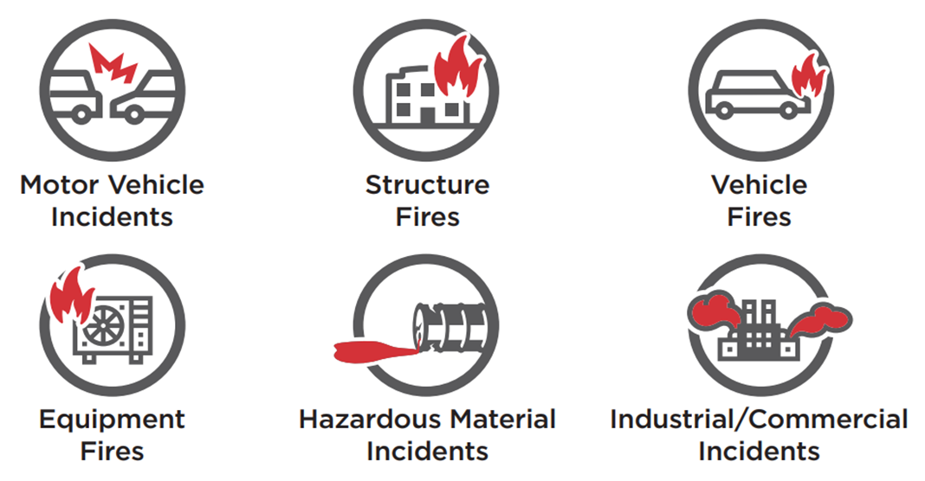
EMERGIFIRE – Fire Response Billing
Billable fire incident costs include personnel, equipment, and debris removal as well as inspections and permit building.

Slide 47
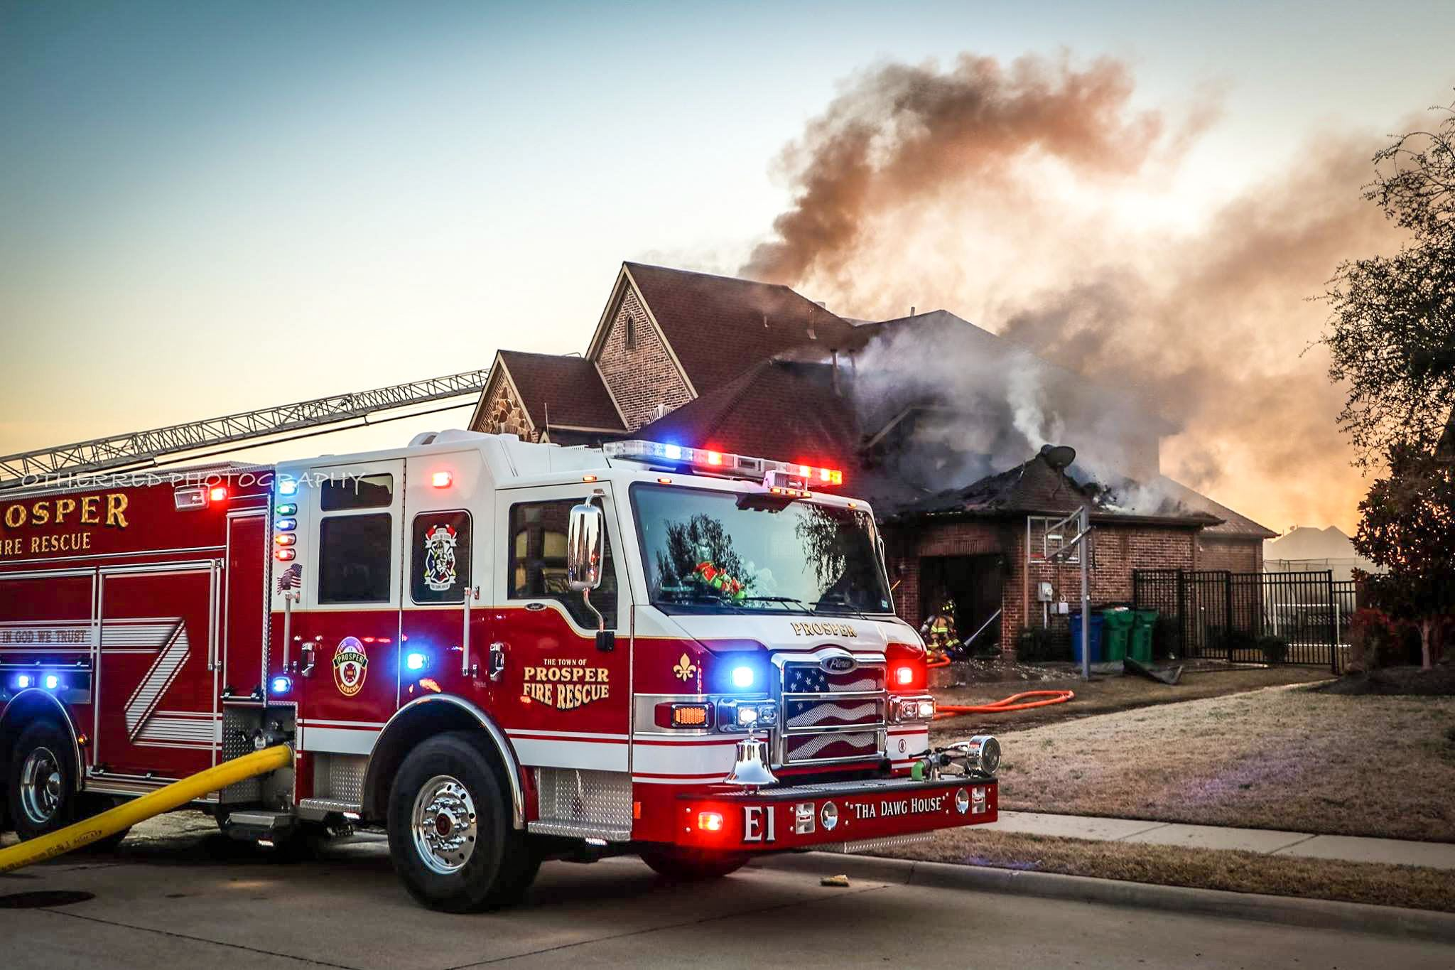
Questions?

Slide 48
Agenda Item 14.
Consider and act upon an ordinance amending Chapter 5.05 of the Towns Code of Ordinances, by repealing existing Article 5.05, “Hazardous Materials Incident Response,” and replacing it with a new Article 5.05 “Mitigation Rates for Emergency and Non-Emergency Services”, amending Appendix A, “Fee Schedule,” to the Town’s Code of Ordinances by adding a new section XXIII, “Fire Department Mitigation Rates,” of Appendix A, “Fee Schedule,” to this Code of Ordinances. (SB)

Slide 49
Agenda Item 15.
Discuss and consider Town Council Subcommittee reports. (DFB)

Slide 50
Possibly direct Town Staff to schedule topic(s) for discussion at a future meeting.

Slide 51
Executive Session
Section 551.087 – To discuss and consider economic development incentives and all matters incident and related thereto.
Section 551.072 – To discuss and consider the purchase, exchange, lease, or value of real property for municipal purposes and all matters incident and related thereto.
Section 551.074 – To discuss and consider personnel matters and all matters incident and related thereto.
Section 551.071 - To consult with the Town Attorney regarding legal issues associated with code enforcement and law enforcement activities, and all matters incident and related thereto.

Slide 52
The Town Council will reconvene after Executive Session.

Slide 53
Reconvene into Regular Session and take any action necessary as a result of the Closed Session.

Slide 54
Adjourn.

